Slide 1

Altair Python Library
Kyle Wolff

Slide 2
What is altair?
Altair is a Python library for statistical data visualization
The library is built on Vega-Lite which is a high-level visualization grammar
Designed for simplicity, clarity, and interactivity
Fits perfectly with Pandas for fast, clean charting

Slide 3
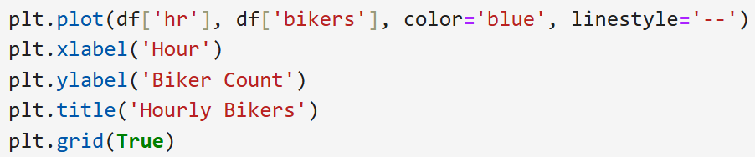
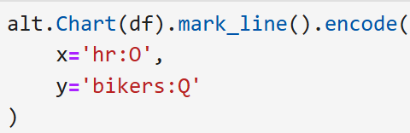
Why use Altair?
Altair uses declarative syntax: you describe what to show and not how to draw it
In Matplot or Seaborn you have to manually control how chart is drawn
Built-in interactivity like tooltips, zooming, and filters
Great for exploratory data analysis and quick visualizations
Matplotlib or Seaborn
Altair

Slide 4
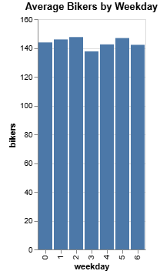
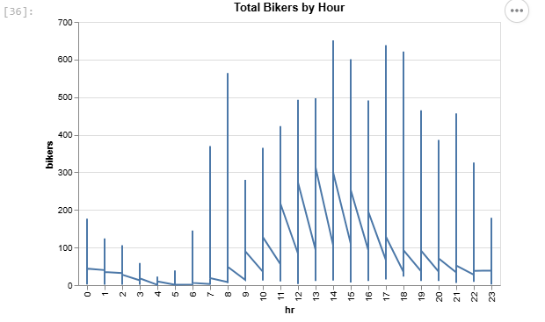
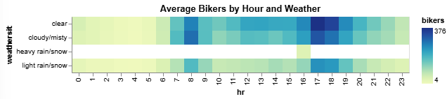
Altair in Action

Slide 5
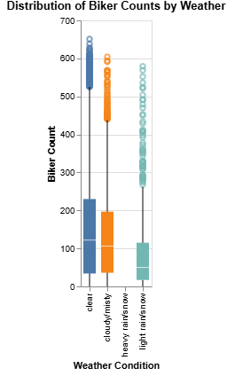
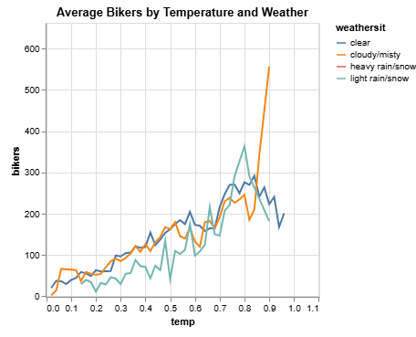
More Advanced Altair

